Slide 1

Smart ROOM
S3-EE1953-Engineering design
Department of Electrical Engineering
University of Moratuwa
01

Slide 2
Description of the project
In our project we have implemented a smart room using automatic lighting system with IOT based remote controlling.
When person enters the room, Bulb will turn on with the intensity of the light inside the room, And turn off when the person leaves the room or nobody inside the room.
We can also switch on the appliances inside the room through mobile or using any smart devices from anywhere.
 | Dark time | Day time
Person in room | Bulb on | Bulb off
No one in room | Bulb off | Bulb off
03

Slide 3
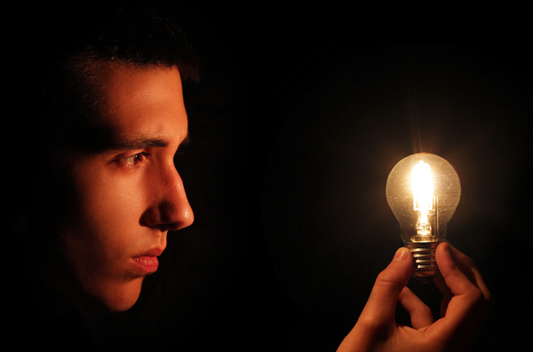
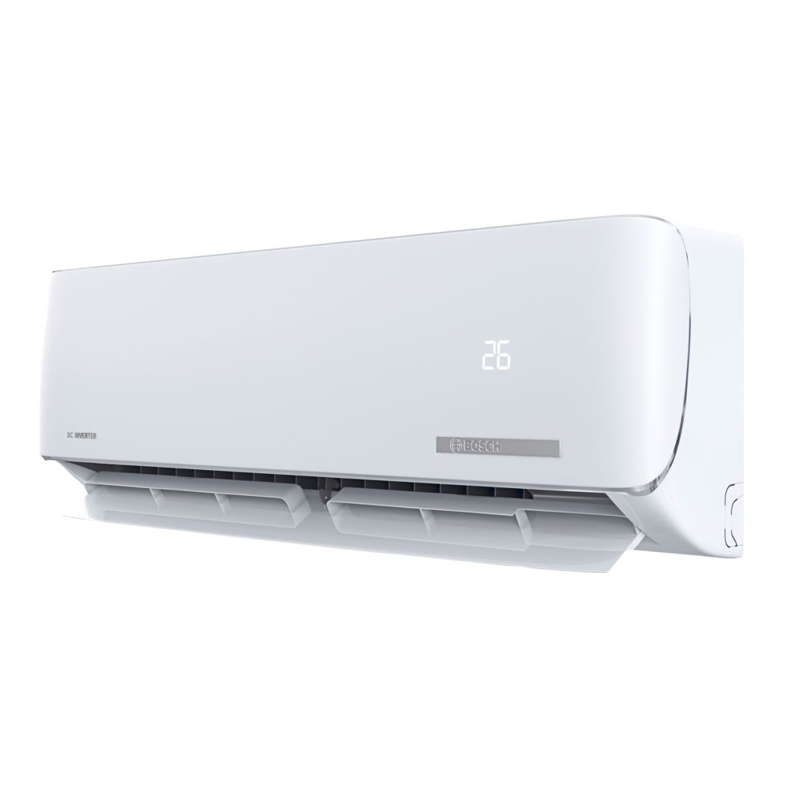
Reason for our project:
Power saving by operating the bulbs and other appliances in efficient manner
Can control from anywhere in the world
Convenient use
04

Slide 4
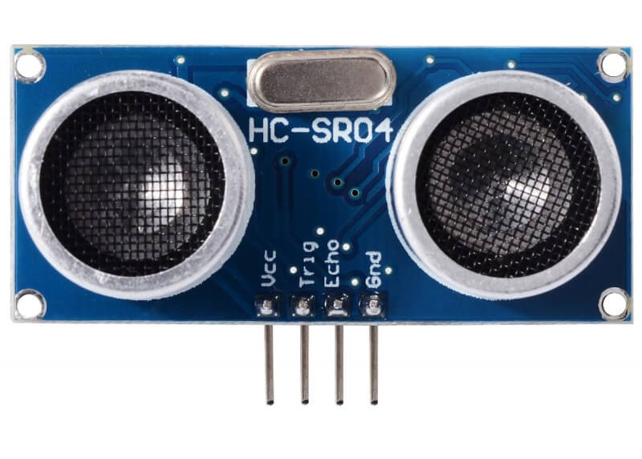
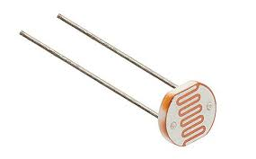
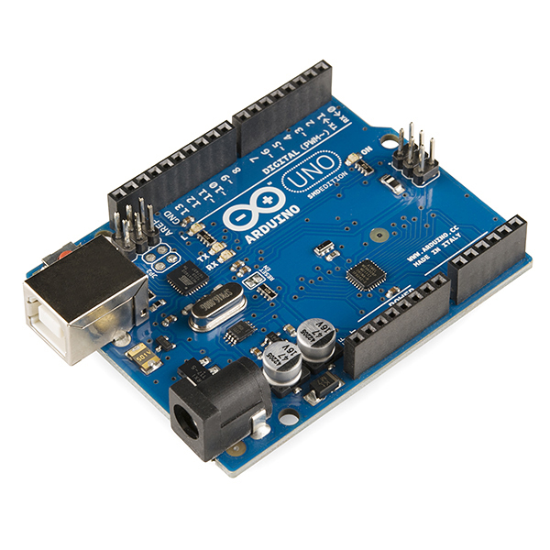
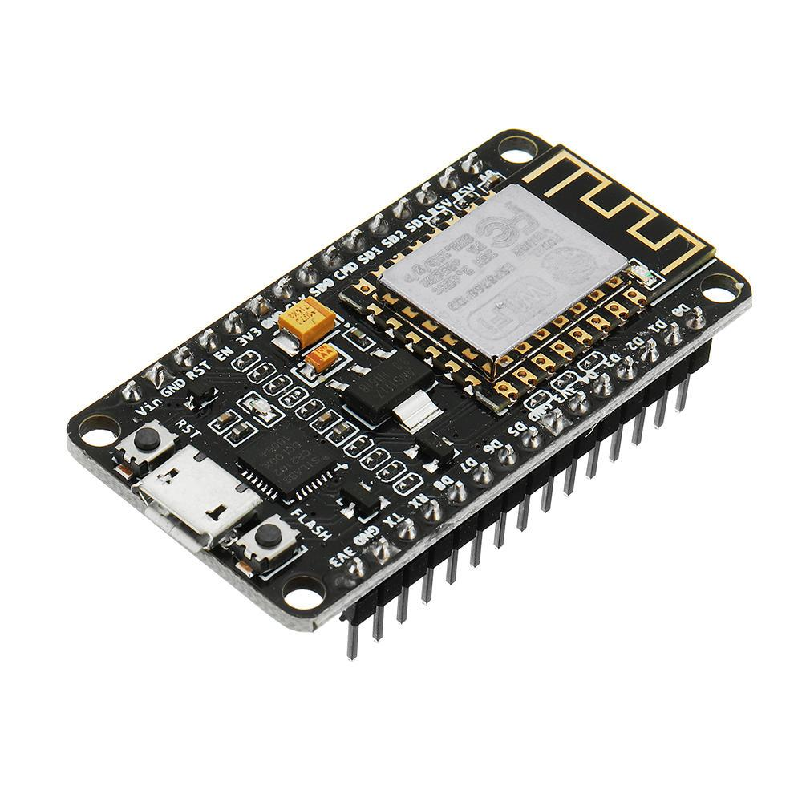
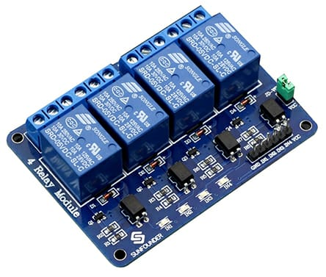
Sensors and other components
Ultrasonic distance sensor
LDR
Specification: HC-SR04
Arduino Uno board
Wi-Fi module ESP8266(nodemcu)
Relay
05

Slide 5



Software used……
proteus
Arduino
Arduino iot cloud
06

Slide 6
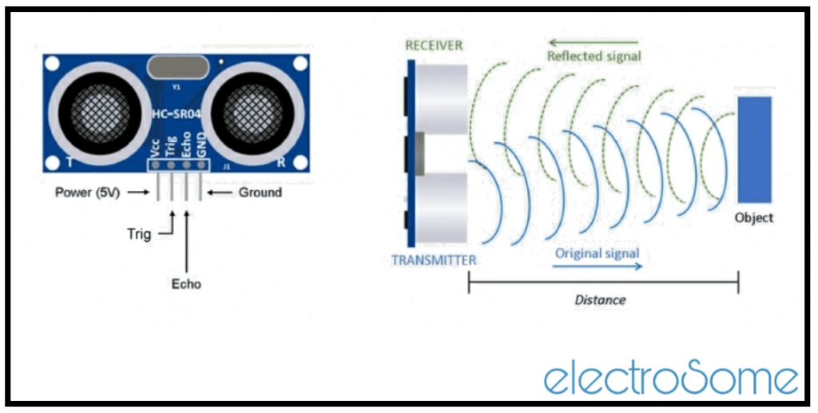
Ultrasonic sensor working principle
08

Slide 7
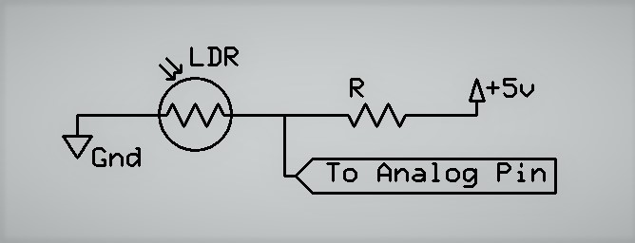
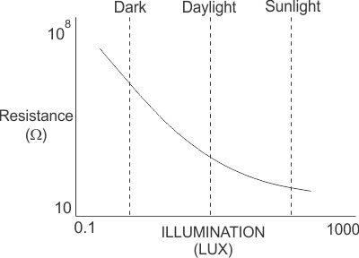
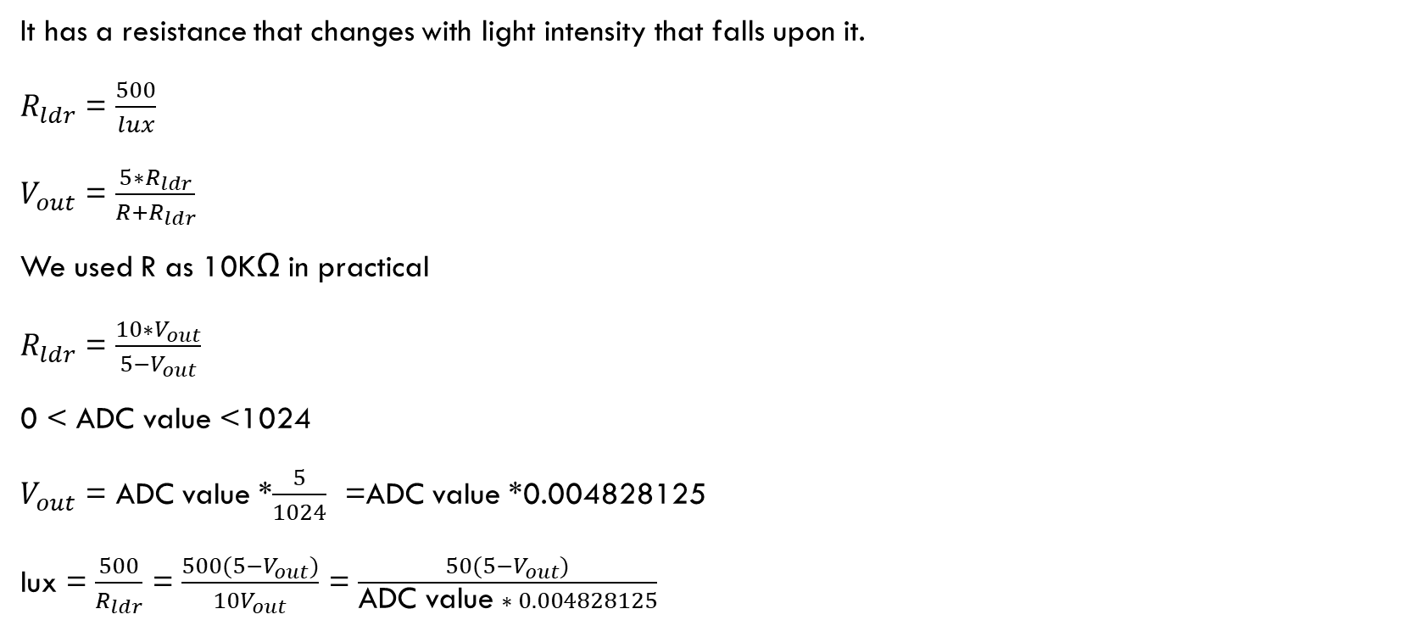
LDR Sensor
It has a resistance that changes with light intensity that falls upon it.
$R_{ldr}$ = $\frac{500}{lux}$
$V_{out}$ = $\frac{5∗R_{ldr}}{R+R_{ldr}}$
We used R as 10KΩ in practical
$R_{ldr}$ = $\frac{10∗V_{out}}{5−V_{out}}$
0 < ADC value <1024
$V_{out}$ = ADC value *$\frac{5}{1024}$ =ADC value *0.004828125
lux = $\frac{500}{R_{ldr}}$ = $\frac{500(5−V_{out})}{10V_{out}}$ = $\frac{50(5−V_{out})}{\text{ADC} \text{value} ∗ 0.004828125}$
Resistance vs lux

Slide 8
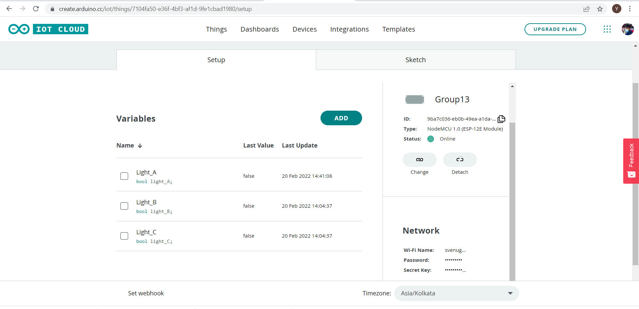
IOT Cloud Interface

Slide 9
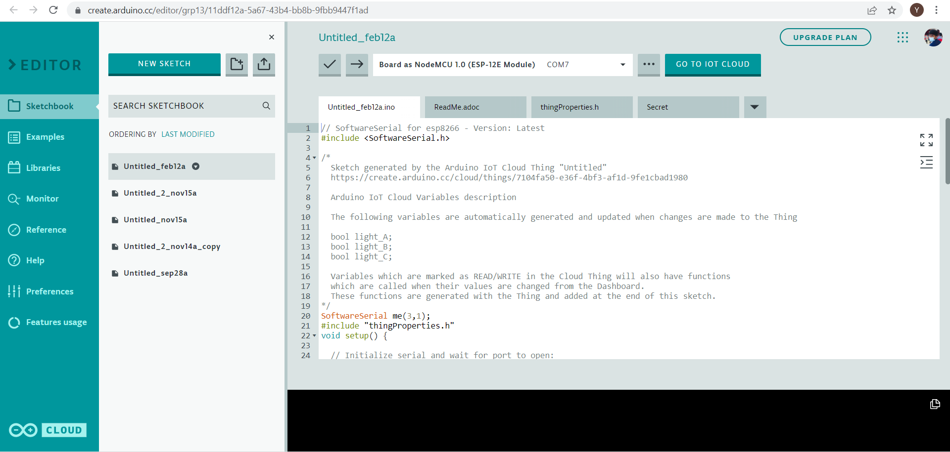

Slide 10
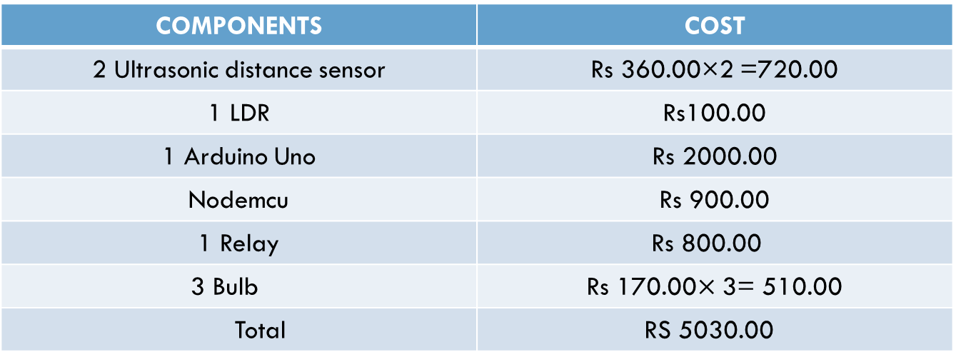
Budget
COMPONENTS | COST
2 Ultrasonic distance sensor | Rs 360.00×2 =720.00
1 LDR | Rs100.00
1 Arduino Uno | Rs 2000.00
Nodemcu | Rs 900.00
1 Relay | Rs 800.00
3 Bulb | Rs 170.00$×$ 3= 510.00
Total | RS 5030.00
09

Slide 11
Group members
Subaraj .B 190605T
Laksman .P 190347D
Jalini .S 190246R
Kirushan .T 190318P
11

Slide 12
THANK YOU!

